Slide 1
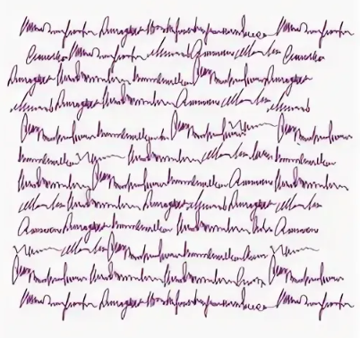
Handwritten Text Recognition
PREPARED BY:
DMITRY BOGOSLOVTSEV
ALEXEY TROFIMOV
YURI MIRONOV
FARID FATEKHOV

Slide 2
Project background
Lots of people still use handwritten text as a form of making notes or containing information because it’s more convenient for them or simply because of the requirements. However, we are getting towards the overall digitalizing at a very high pace. There is a plenty of archives that needs to be digitalized as well as there are many people like students or writers that have their workbooks lying somewhere in the cabinet and waiting to be published. Even though, those drafts and summaries might be really helpful for others it needs too much time and efforts to retype it manually into computer.

Slide 3
Project aim
Our goal is to ease this task by making a program that will recognize English handwritten text by photo or scan of it and converting it into digital form. So that many useful documents may be published without the need to type the text manually from sheets into computer.
Our targeted parameter is at least 90 % accuracy in handwritten text recognition.

Slide 4

Tasks to be solved to achieve the goal of the project
To find appropriate hyper-parameters for CNN model training.
To correct mistakenly detected symbols with the help of existing libraries.
To develop desktop and web application.

Slide 5
Target audience
Students
Teachers
Writers
Archives
Scholars

Slide 6
Short product description
This is a trained convolutional neural network wrapped inside a script written in Python. Neural network will be first trained on dataset of images to achieve high accuracy score. Firstly, user uploads the photo or scan of text and script divide text into letters, then every letter is to be recognized by neural network. At the end all recognized letters recompile together into a word, which then is being spell checked. If some letters are missing or incorrect, or program suggest most likely result.
For our project we made a simple desktop application and web application which is more user-friendly in comparison with the console interface.

Slide 7
Existing analogues
Microsoft OneNote
Google Drive and Google Docs
Simple OCR
Online OCR
TopOCR
FreeOCR

Slide 8
Applied resources with refs
Kaggle.com – used a dataset with English letters https://www.kaggle.com/datasets/vaibhao/handwritten-characters/code?datasetId=53376
Github.com – https://github.com/CISgroup1/HTR_GUI_PyQt
Stackoverflow.com
Docs.python.org
Habr.com

Slide 9
Detailed description of the processes (IDEF0 diagram)

Slide 10
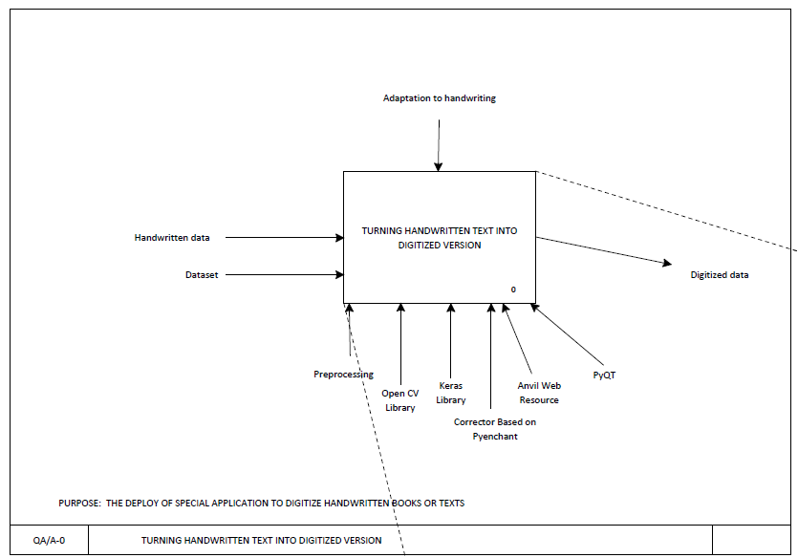

Slide 11
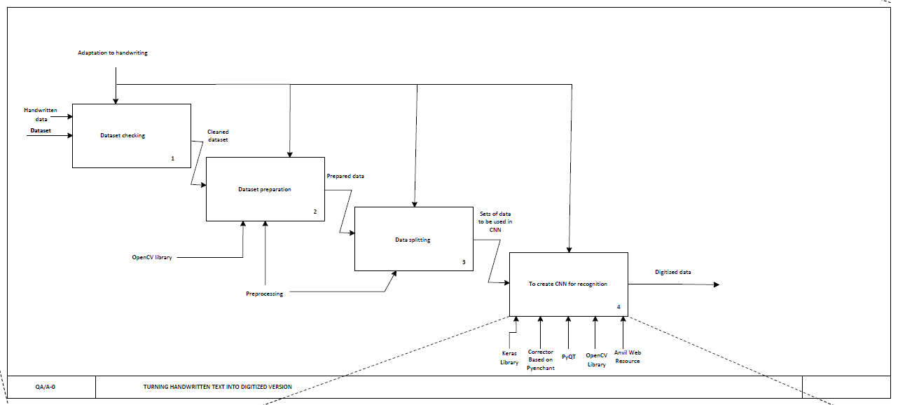

Slide 12
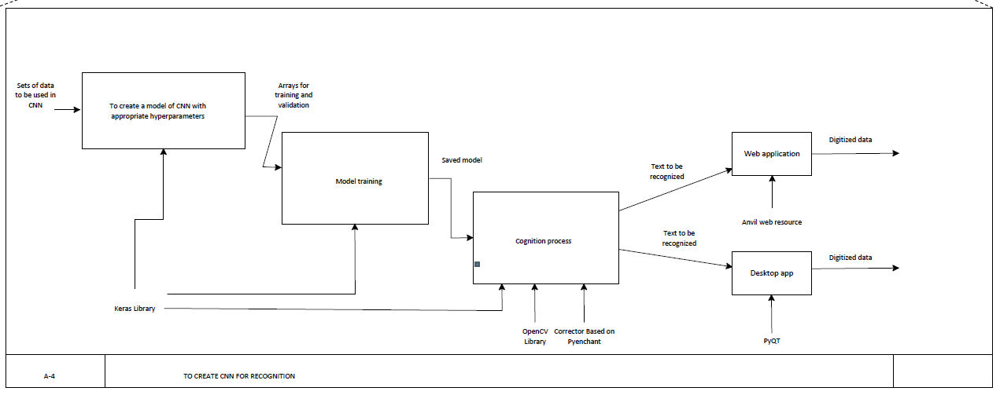

Slide 13
Components needed for the solution
1. Dataset.
2. Trained Convolutional Neural Network (CNN).
3. Knowledge base (KB) where we are parsing hyper-parameters.
4. Server/Client interactions with the help of web application.

Slide 14
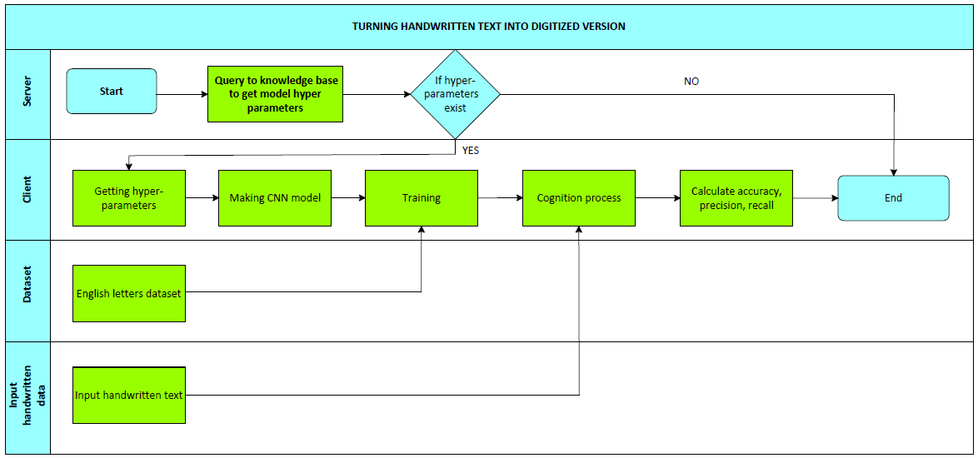
Swimlane diagram

Slide 15
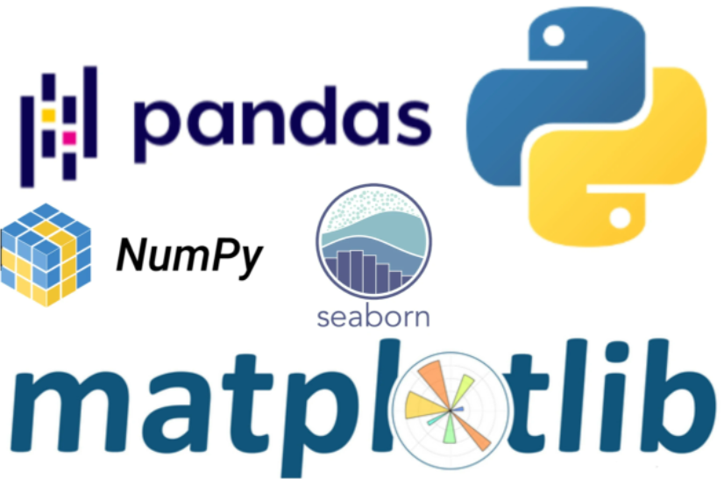






Basic Python Libraries we used in the project

Slide 16
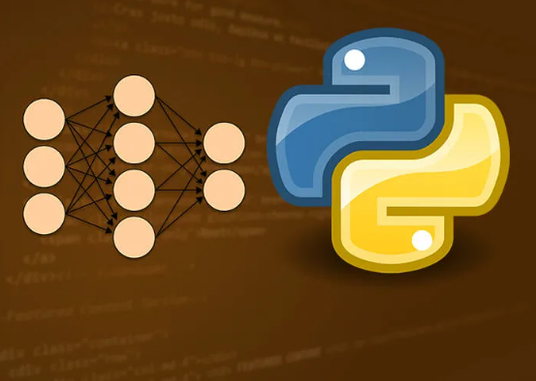
Neural Network description

Slide 17
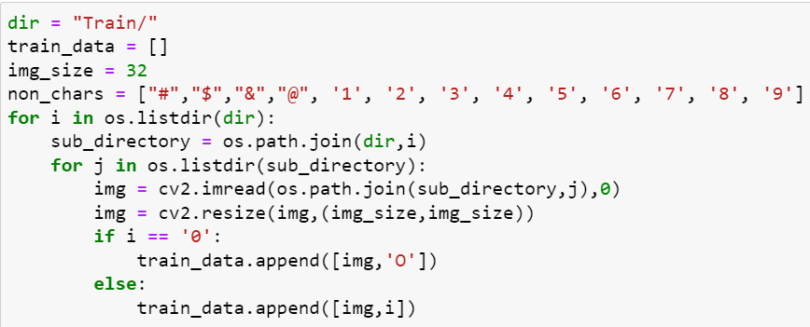
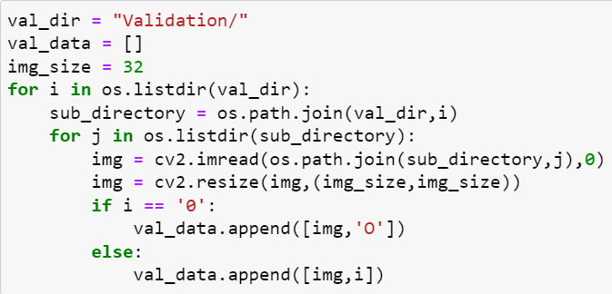
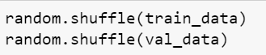
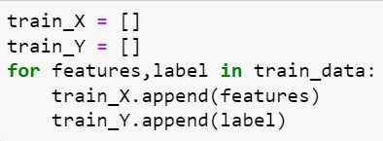
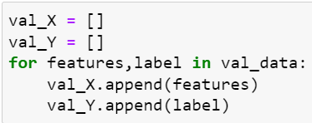
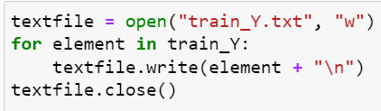
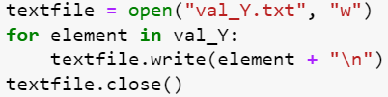
Data reading and preprocessing
Firstly we upload images and labels from our dataset avoiding symbols and numbers. By doing that we also resizing image to 32x32 pixels.
Then we shuffle the data and separating the features from labels. After that we need to save our labels (they will be needed further).

Slide 18
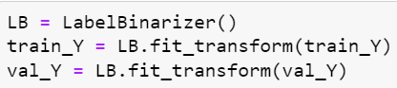
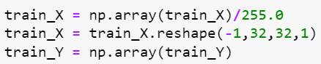
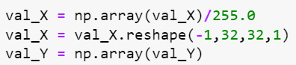
Then we transform labels into binary form and make array out of them. Our next step is to scale our train dataset between 0 and 1, where 0 will be absolute black and 1 – absolute white. Moving forward, we have to reshape our dataset to make it readable by Tensorflow. Here -1 for input x specifies that this dimension should be dynamically computed based on the number of input values in x, holding the size of all other dimensions constant. This allows us to treat batch_size(parameter with value -1) as a hyperparameter that we can tune. And 1 stands for the number of channels (since we work with grayscale).

Slide 19
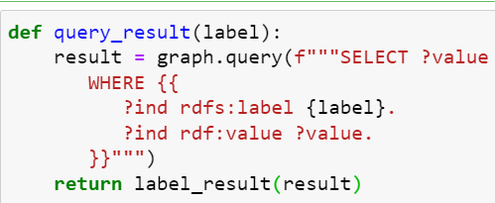
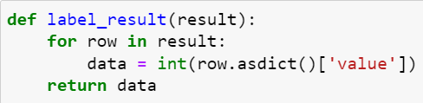
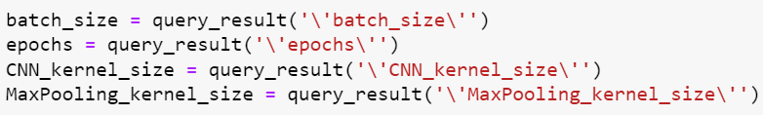
Parsing hyperparameters from KB
Firstly, we create the Graph entity. Further we define functions to extract data from our KB and call them. The results are hyperparameters for our model.

Slide 20
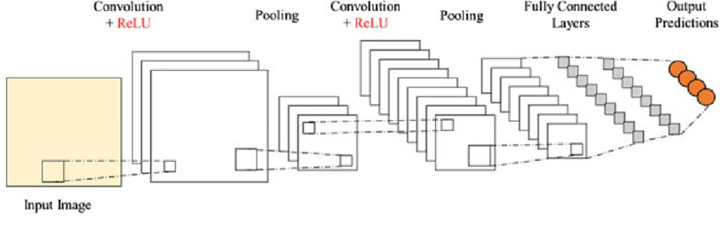
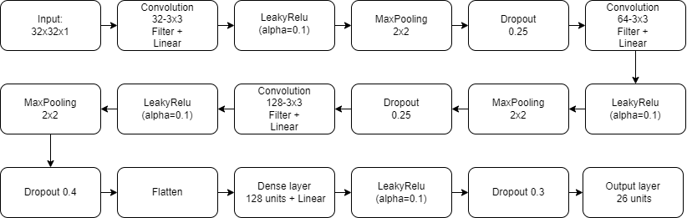
Model structure

Slide 21
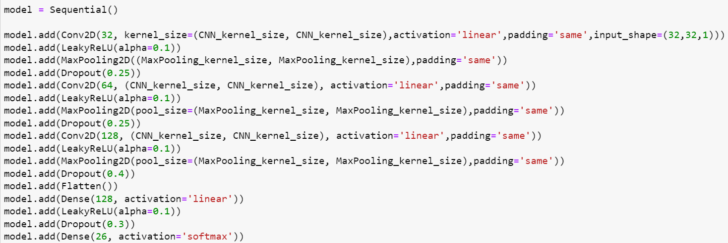
We use CNN model with MaxPooling and LeakyRelu activation function. LeakyReLU prevents the “vanishing gradient” problem, so it is more effective where you have plenty of values below zero. After each layer we have a Dropout function to ensure that our model won’t overfit. Kernel size of the CNN is (3,3) and kernel of Maxpooling is (2,2).

Slide 22
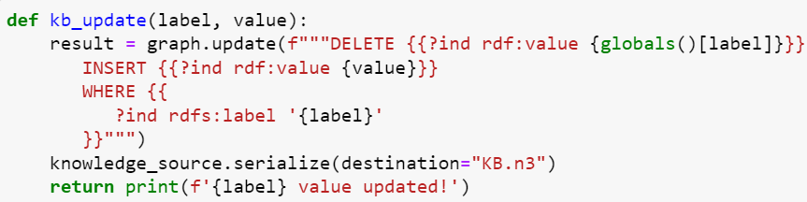
We achieved the best result on 20 epochs and 64-batch size training (around 93% accuracy on validation data). After training we save the model, and define the function to update our hyperparameters, in case we manually changed them.

Slide 23
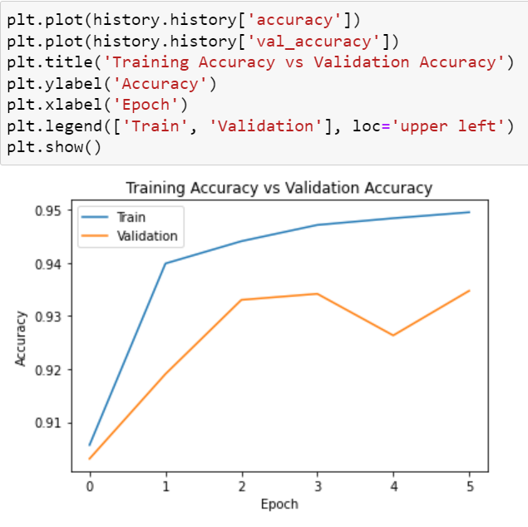
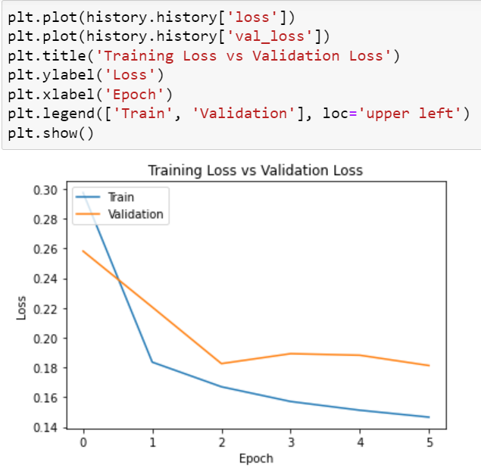

Slide 24
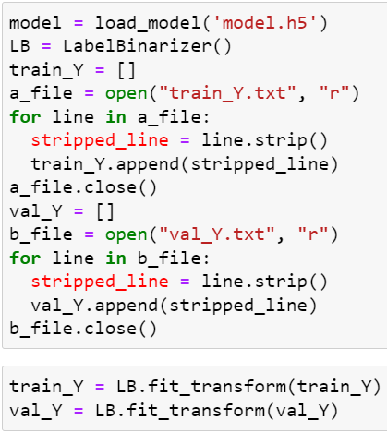
Loading of model and labels
In our main file, which we use for frontend, we load our model and labels and then transform labels into binary form.

Slide 25
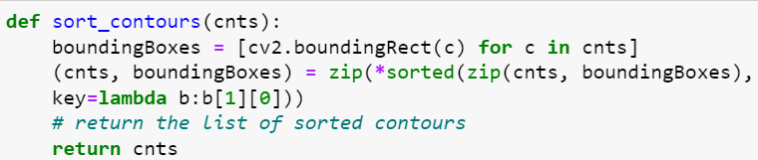
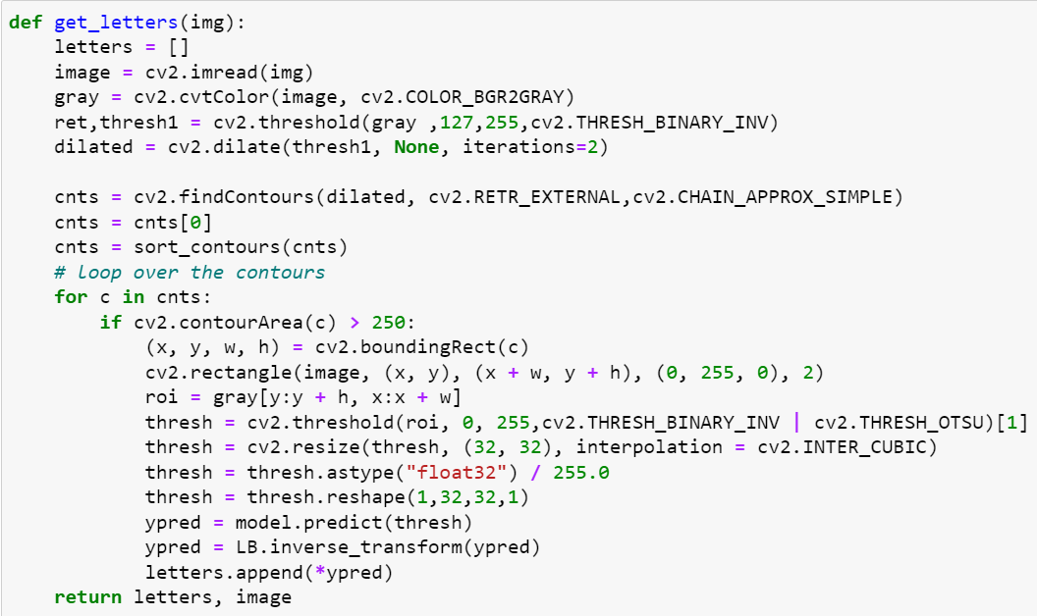
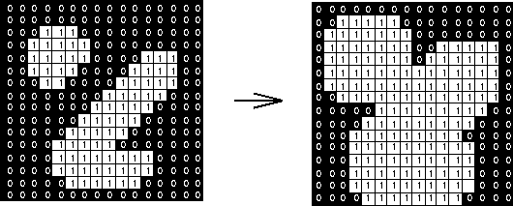


Data scanning and prediction
Firstly, we read the image and convert it into grayscale form. Then we apply image thresholding using 127 as a minimum and 255 as a maximum threshold with binary inverted method (because our model is trained on dataset with already inverted images). This is needed to avoid noises on photo. After that, we dilate the image (dilation adds pixels to the boundaries of objects in an image), which is helpful to connect fractured object on photo. The example is on the image below.
Next, we retrieve extreme outer contours of letters and compress horizontal, vertical, and diagonal segments leaving only their end points.
Then we sort our contours by firstly calculating the up-right bounding rectangle of a point set or non-zero pixels and zipping them with our contours and then applying sorting algorithm. Then we loop over our contours with area threshold of 250 to avoid noises and draw rectangles with letters on image. After that, we apply thresholding algorithm (here we use combination of binary inverted and Otsu algorithm) and resize every letter with interpolation (it helps to resize image with minimal quality loss). Then, we convert them to binary form, scale them and reshape, same as we did for our model to train. Finally, we predict the letter using our trained model and transform numeric prediction into label (that’s why we loaded our labels and transform them into binary before), making the list of predicted letters.
Image dilation
No interpolation
After interpolation

Slide 26
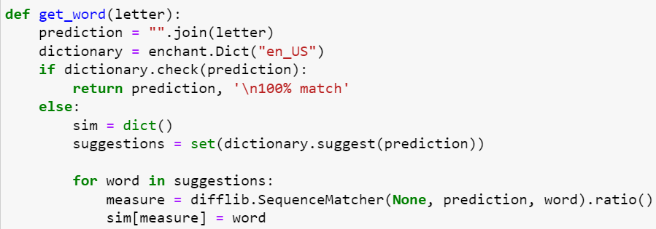
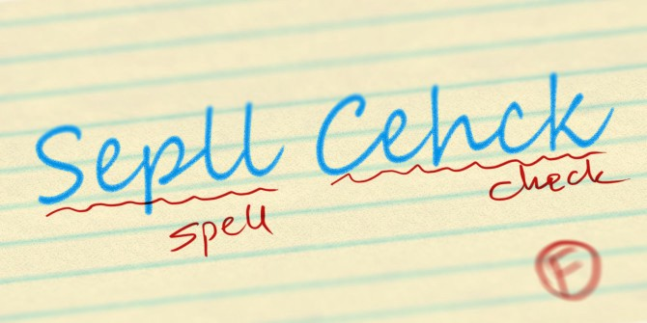
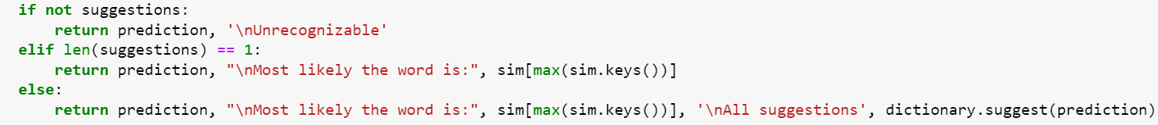
Spell check
To compensate imperfection of our model we added a spell check by the help of Enchant and Difflib libraries. Hence, when our model make a mistake with prediction of some letters the word is being checked in dictionary (which is embedded into Enchant library). Then, Enchant give us suggestions of most likely words. The sim dictionary will store the similarity values (range from 0 to 1) of the words proposed by the suggest() method of the Dict class with the search word. We get these values in a loop when calling the ratio() method of the SequenceMatcher class and write them to the dictionary. At the end, we get the word that is as close as possible to the one being checked and other suggestions if they are > 1.

Slide 27
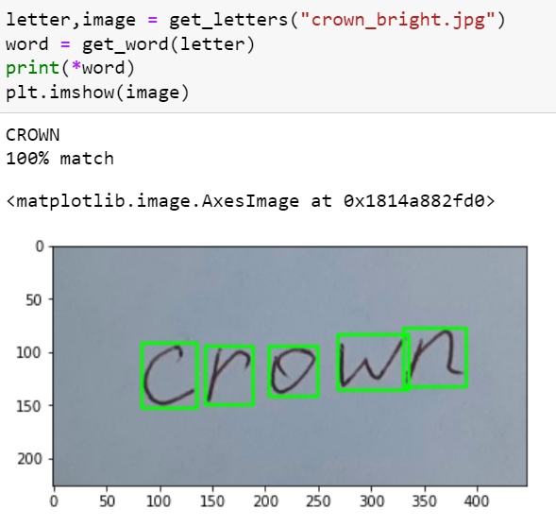
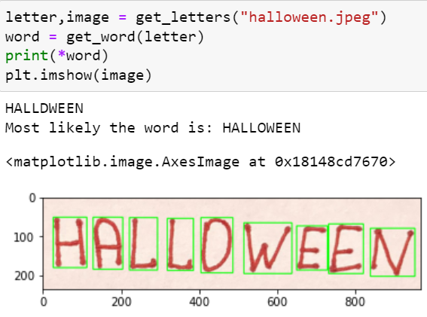
Final results

Slide 28
Desktop and web application
Simple and clear interface was created to be more user-friendly. The only thing you need is scanned text or text photo to be recognized.
Code in details: https://github.com/CISgroup1/HTR_GUI_PyQt

Slide 29

Desktop application description

Slide 30
Desktop app development
Desktop application has been built using PyQt5 library considering Python as a main programming language of our course.
PyQt is a Python version of the Qt Framework. Qt is an open-source framework written in C++. It is used to build GUIs easily with widgets that are commonplace in desktop applications.

Slide 31
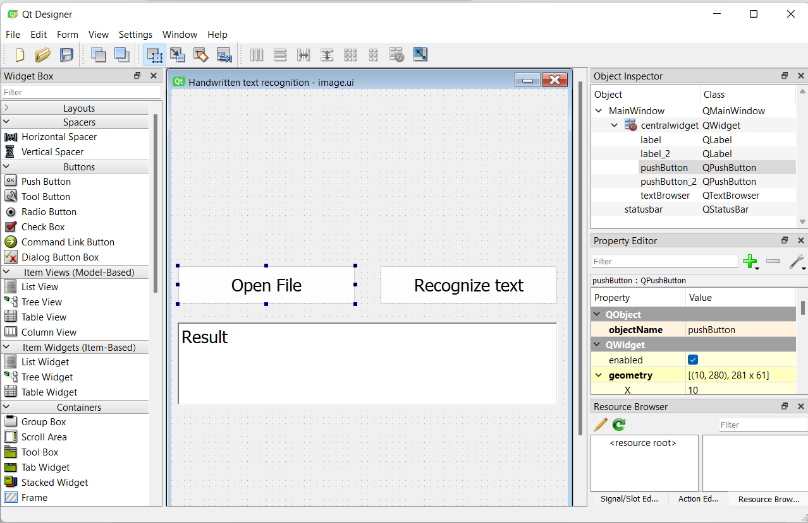
Desktop app development
Step 1. Creating GUI
The PyQt installer comes with a GUI builder tool called Qt Designer. Using its simple drag and drop interface, a GUI interface can be quickly built without having to write the code.

Slide 32
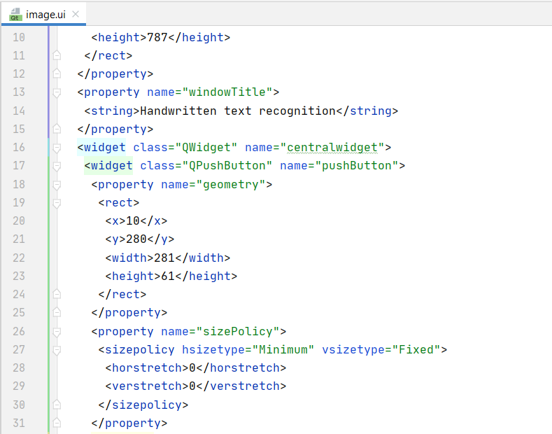
Desktop app development
Step 2. Exporting widgets
In Qt widget is the name given to a component of the UI that the user can
interact with.
Qt Designer application had been used to quickly build widgets, and then export them as .ui files.

Slide 33
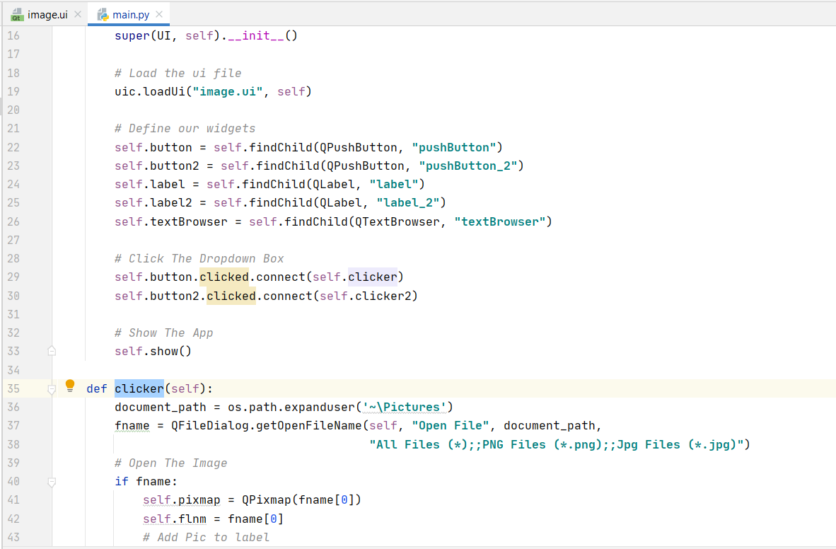
Desktop app development
Step 3. Importing UI into Python code
To load .ui files we can use the uic module included with PyQt5, specifically the uic.loadUI()method.

Slide 34
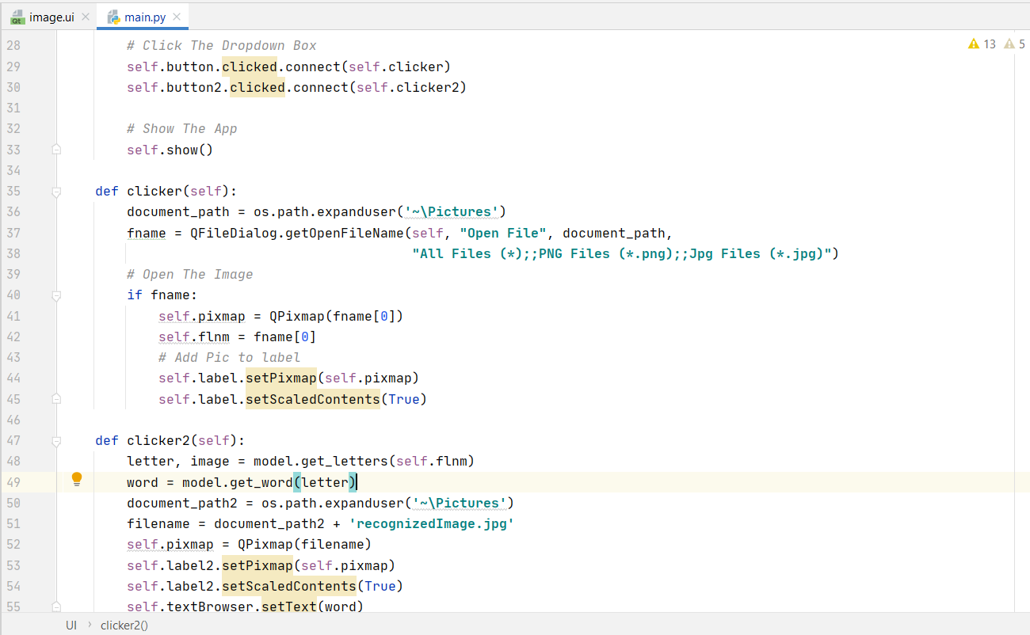
Desktop app development
Step 4. Defining functions for widgets
After loading GUI file into memory, widgets behavior can be described using Python code

Slide 35
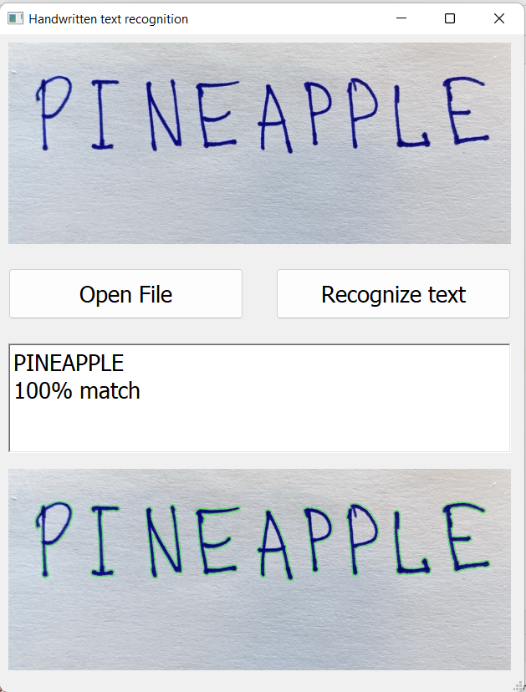
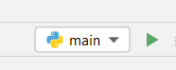
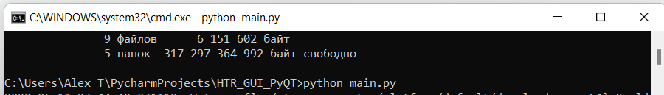
Desktop app development
Step 5. Running the app
Finally, just press the ‘Run’ button in IDE
or run the file using command: python main.py

Slide 36

Web application description

Slide 37





Web app development using Anvil (architecture)
HTTP:\\... IP address
Web app
@anvil.server.callable (anvil server)
Anvil uplink
Python client
Data
Data
Functions Calls
Frontend
User
Upload the file with text to recognize on web page

Slide 38
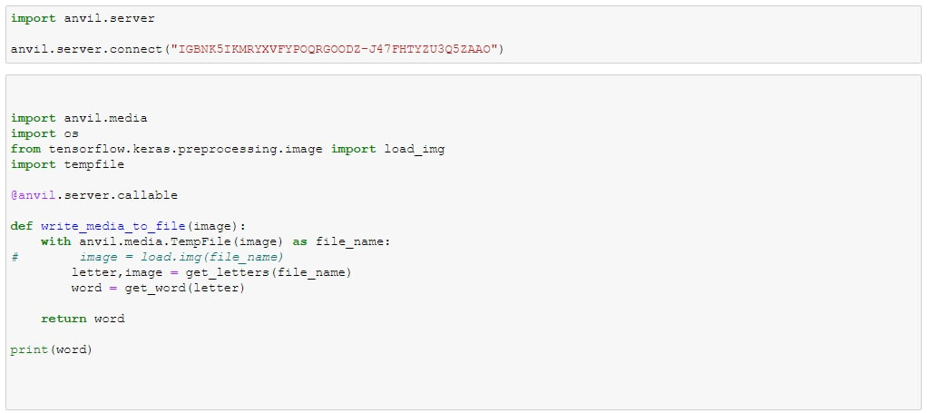
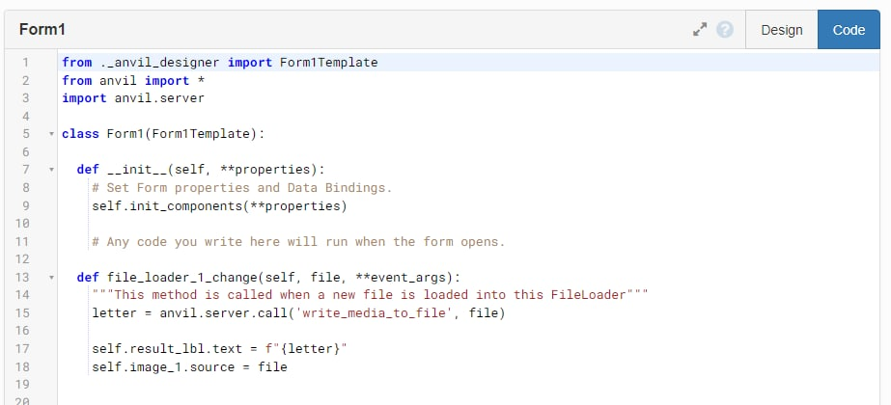
Web app development (code)
Callable part code on Python client
Anvil part code on cloud server

Slide 39
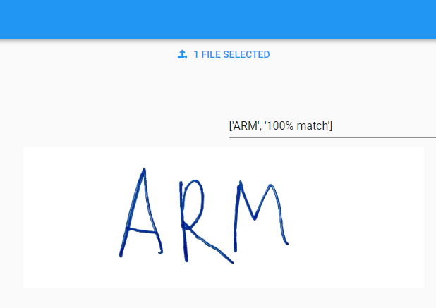
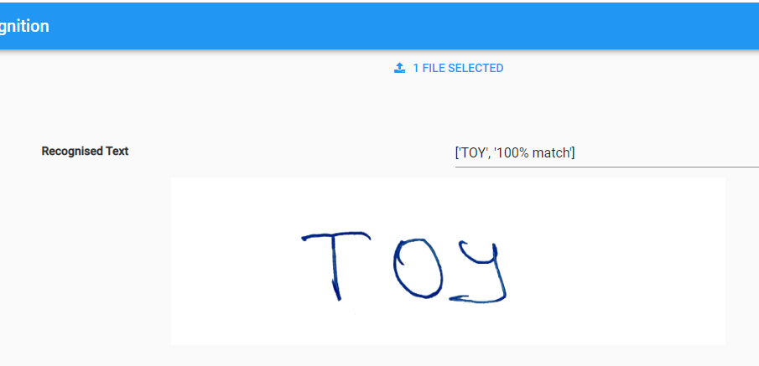
Web app (recognition)

Slide 40
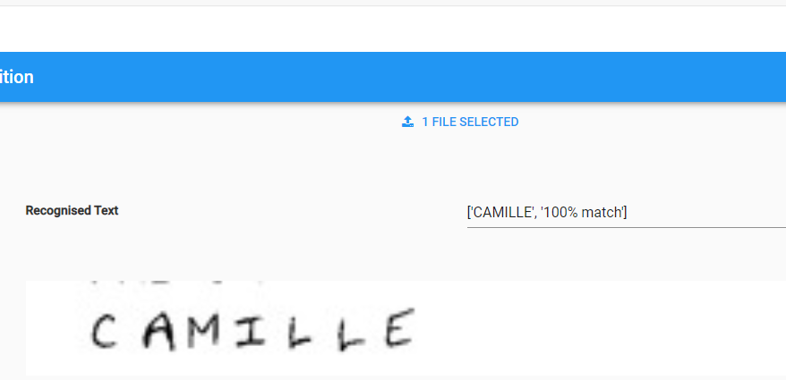
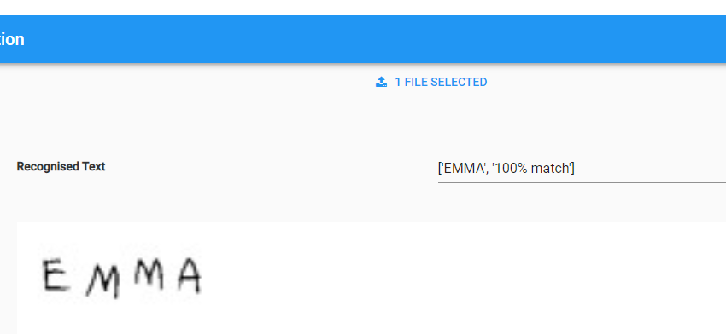
Web app (recognition)

Slide 41
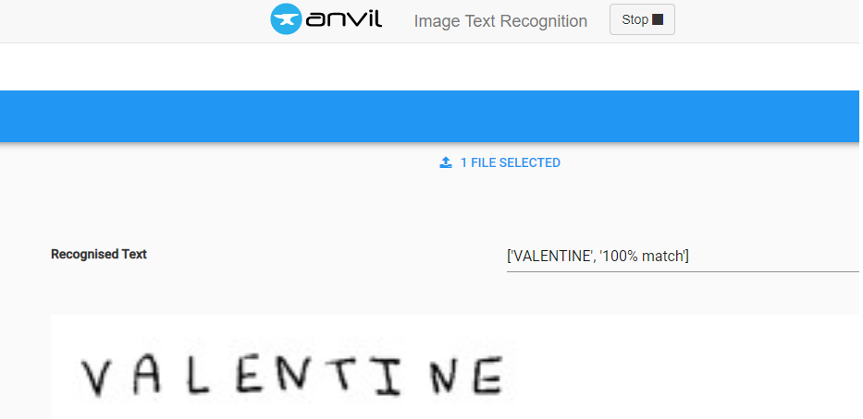
Web app (recognition)

Slide 42
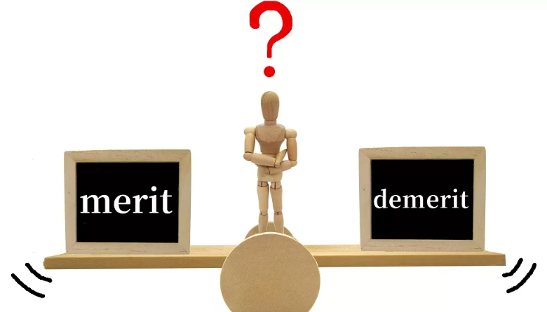

Conclusion
Drawbacks of the project:
1. Program is quite sensitive to the quality of scanned word. Some dots or other noises could be wrongly recognized as symbols.
2. The program cannot recognize properly tied words.
3. The program cannot recognize properly a text. OpenCV scales text and during the recognition makes incorrect symbols classification. For instance:

Slide 43
Merits of the project:
1. In carrying out the project, we applied the knowledge that we acquired while studying other subjects of educational term.
2. User-friendly interface of web and desktop apps.
3. The topic of the project is relevant and we can further develop our achievements in the future.
Unfortunately, we were not able to fully achieve the goal of our project. The initial task was not as simple as it seemed before. Many examples of similar projects do not have easy solutions. However, we were able to improve our program interface, add spell checking after CNN model recognizing, make our own web and desktop application.
In order to reach the target of handwritten text recognition it is necessary to dive deeper for that scope of knowledge and maybe in the future we’ll apply more advanced approaches. Hereunder, some of them.

Slide 44

Possible ways to improve final results
1. Usage of more precised datasets to train the model.
2. Editdistance and CTCModel implementation.
3. Tesseract-OCR and Tesseract library implementation.
4. CNN + LSTM implementation.

Slide 45
Appendices
Dataset used in the project:
https://www.kaggle.com/datasets/vaibhao/handwritten-characters/code?datasetId=53376
Code:
https://github.com/CISgroup1/HTR_GUI_PyQt
Web app:
https://j47fhtyzu3q5zaao.anvil.app/WGWQ3TPZMFB636QBLFANSC6A

